Slide 1
Week 1
Q&A

Slide 2
Basics
2 Datasets (from 2 sensors)
Determining possible correlations between the measurements of sensor 1 and 2
Classifying the weld seam in four categories
OK
not OK
Pollution (lubricant ?)
out of threshold
Question :
Classify by OK-NOK ?
Classify by Gleitmo – WD40 ?
WHAT IS THE EXPECTED OUTPUT ?

Slide 3
Sensors
Sensor 1
three photodiodes
plasma signal (PI_Raw)
temperature signal (T_Raw)
reflection signal (R_Raw)
only the reflection signal was saved
Sensor 2
one photodiode
only the reflection signal was saved in the data set
Sensor 1 and 2 show a linear response in their voltage values for an increasing intensity

Slide 4
Data types
“not OK” 1 if NOT ok
“signal” 1 I exceeds threshold
WD40 1 if lubricated with WD40
Gleitmo 1 if lubricated with Gleitmo
LWMID_1 sequential number, is unique for each weld seam (Weld ID)
LWMID_2 certain part of a weld (1-5)
Signal1_1 – 112 Data from sensor 1
Signal1_dn_1 – 112 normalized raw value with noise reduction for sensor 1.
Signal2_1 – 112 Data from sensor 2

Slide 5
Objective 1
The correlations between sensor 1 and 2 ???

Slide 6
Objective 2
Classifying the weld seam in four categories
penetration weld
Humping
no connection
Connection
Mentioned in the header and than never again ?

Slide 7
Objective 2.1
Based on the data sets, the weld seams shall be classified in the first group in the following three categories:
OK
Not OK
Signal value exceeded
3 possible outputs ?
Classify in 3 categories ?

Slide 8
Objective 2.2
the weld seams need to be classified to one of the following categories (only one of the two alternatives)
Lubricant
No lubricant
Or
WD40
Gleitmo

Slide 9
Week 1: Data exploration
What does the dataset look like? – redundant ? (S1 and S2)
What kind of input features do you have (“images”)
Do you have to conduct the train/test-split manually? - yes
How many sensor signals do not change at all over time?
Are different sensor signals correlated to each other? – yes (S1 and S2 )
What do the labels look like?

Slide 10
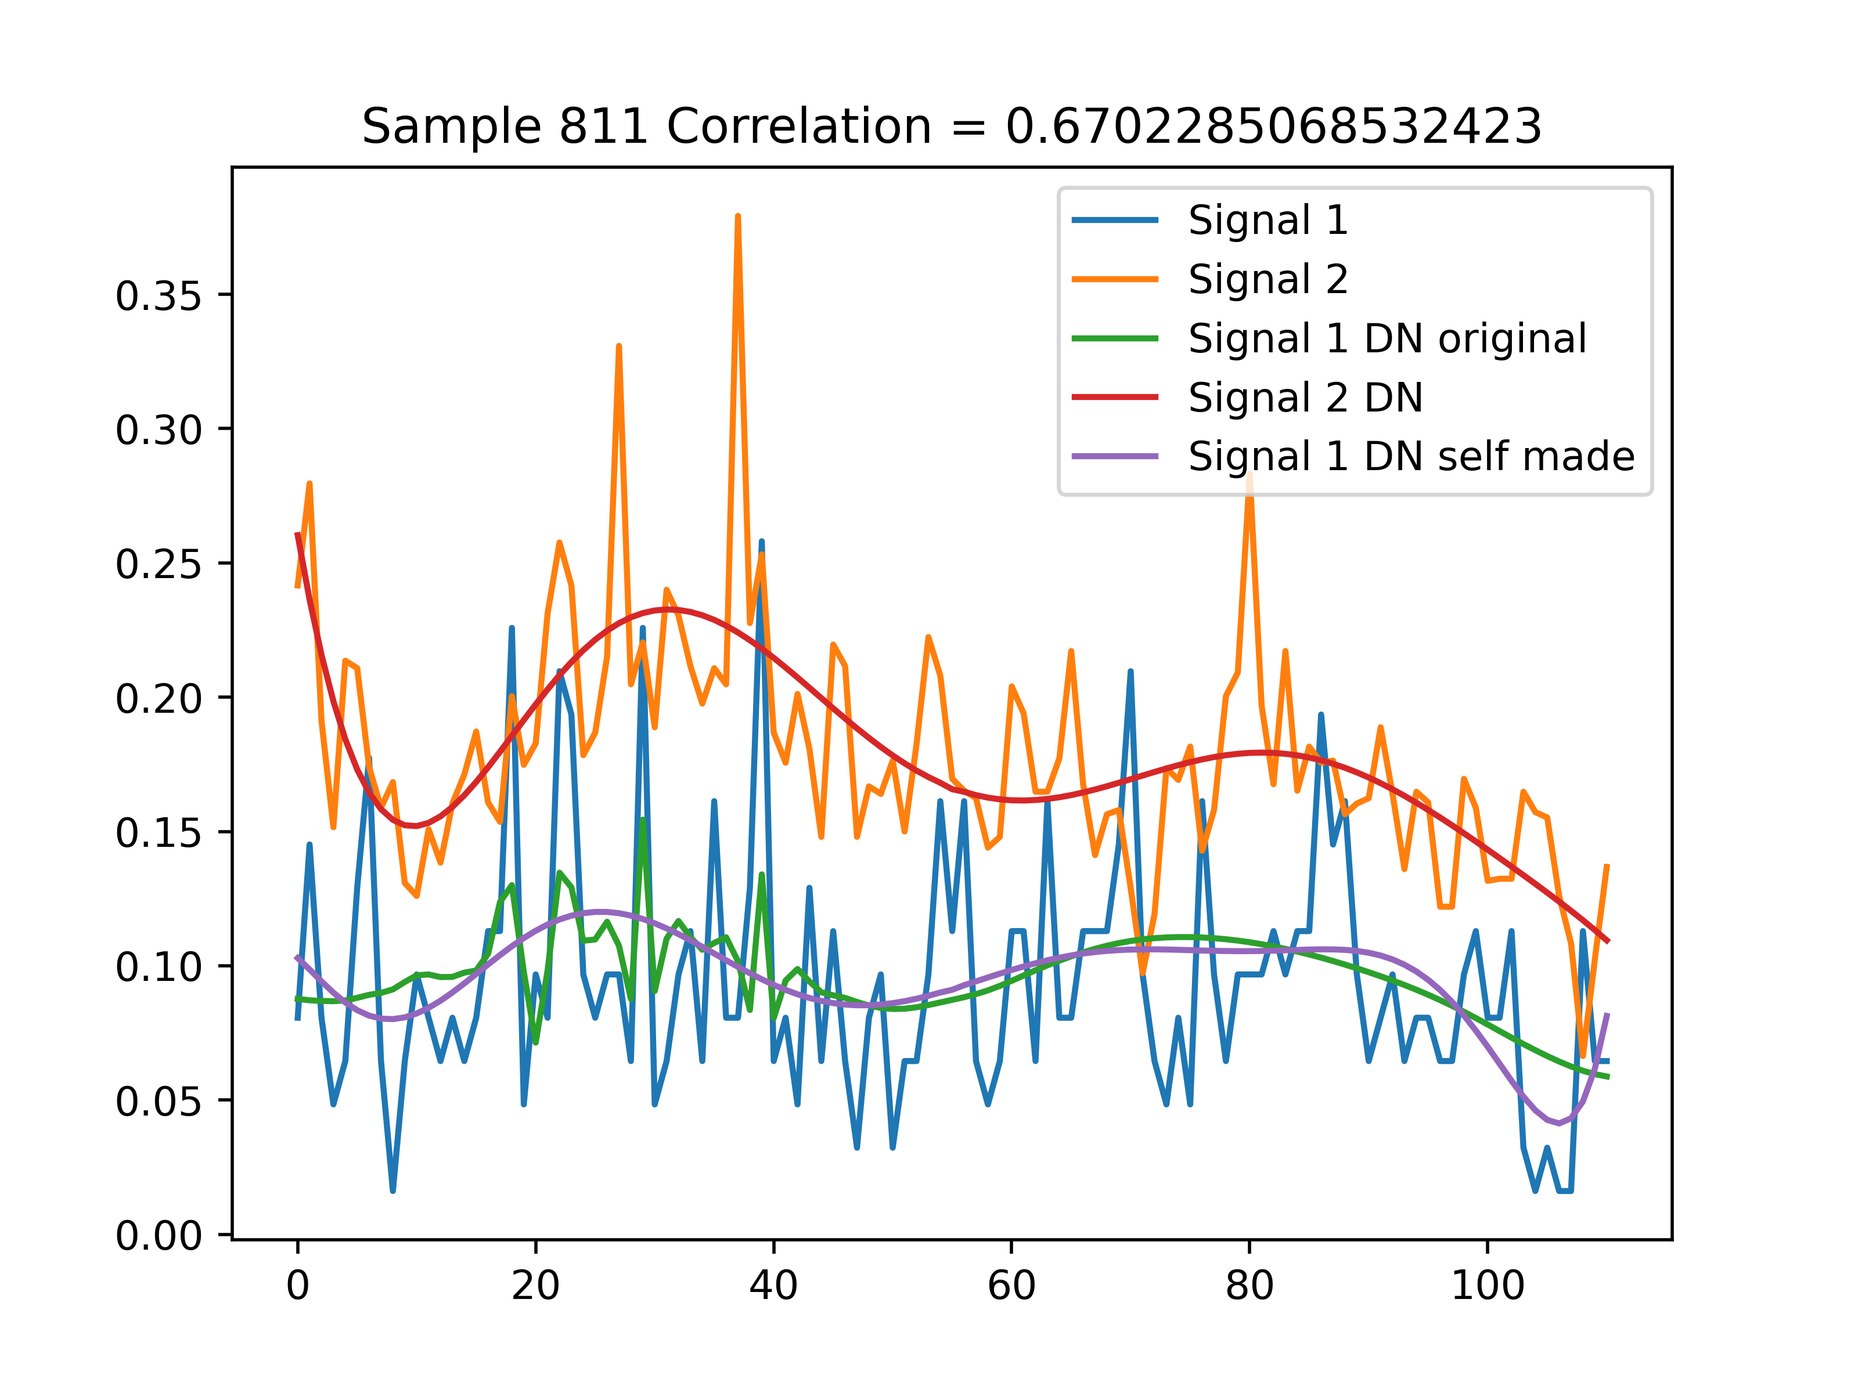
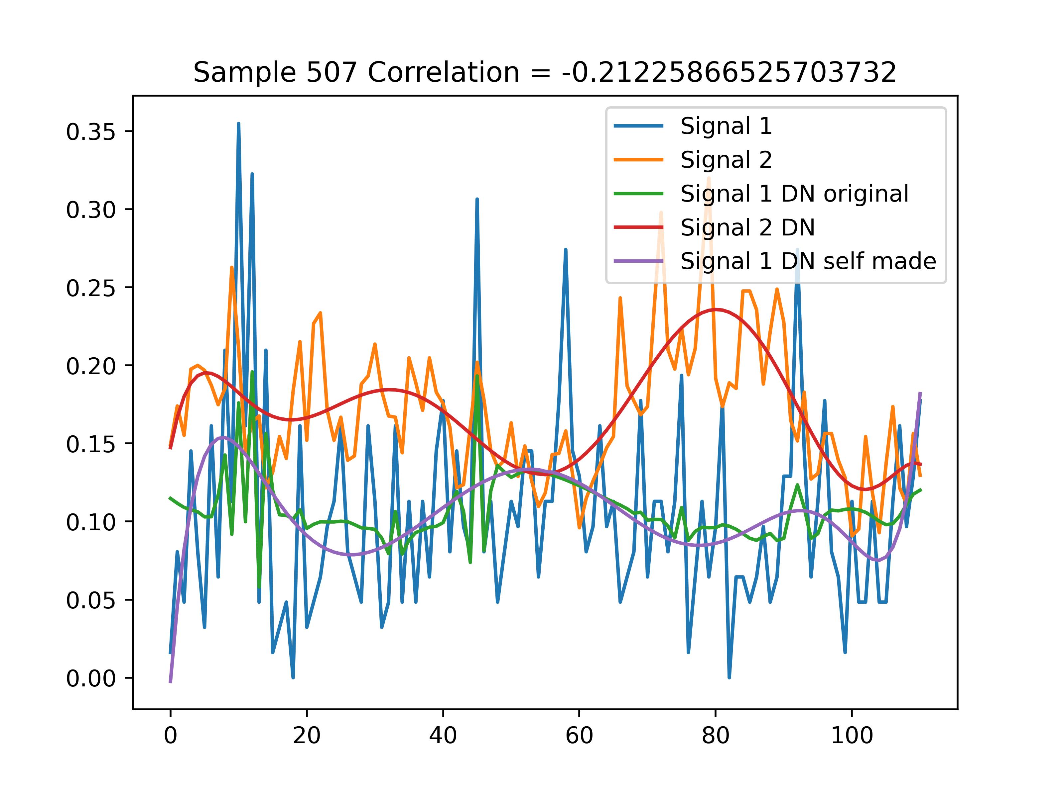
Visualize – sometimes correlating

